Slide 1
A post recession management strategy
Peter Scott
PETER SCOTT CONSULTING
www.peterscottconsult.co.uk

Slide 2
What lessons has the deepest global recession for over 60 years taught you? Has it changed the way you now do business? Will you work differently in the future?

Slide 3
This was how one professional firm responded to the recession
“Our strategy is to keep a lid on expenditure and weather the storm. We
cannot reinvent ourselves as something we are not”
- complacency?

Slide 4
However…
“There seems to be a disturbing strategy of hunkering down, cutting some fat
and hoping that business will return to normal. That is not good. The terrain will
look very different when this is over.
This is not a minor blip, but a discontinuity”
Professor Richard Susskind – May 2009

Slide 5
Your future challenges (and opportunities)?
Economic conditions
The changing needs of clients
Globalisation
Technology
Others?

Slide 6
Above all, the need to be more competitive
“Competition is a process by which …
services that people are not prepared to
pay for
high cost methods of production and inefficient
organisations
are weeded out and
opportunity is given for new…services, methods and organisations to be tried” *
Is this where professional firms are today?
*Everyman’s Dictionary of Economics – A. Seldon and F. G. Pennance 1964

Slide 7
Do you have a plan?
Having been through a recession and become lean and profitable:
Do you plan to stay that way to become super - profitable?
Will you go back to pre-recessionary ways?
or
Is there a smarter and more productive approach to professional life?

Slide 8
Are you determined to become more productive (and profitable) without working any harder?
‘Productivity’ -
‘A smaller input is required to obtain a given output’
‘Work Smarter – not harder!’

Slide 9
Your productivity? Are you measuring what matters? (if you cannot measure it then you cannot manage it)

Slide 10
There is a fundamental question to be considered as professional firms emerge from the recession What kind of firm do we (realistically) want to be?

Slide 11
This will require forward planning – to focus on the fundamentals of your business
Your clients
Your people

Slide 12
Are you making the most of them?

Slide 13
Do you know what services your clients will need in the future? Do you ask them?

Slide 14
Key issues for clients?
Client – based research consistently demonstrates that unless professional firms listen to their clients and act accordingly, then those clients are likely to migrate to other firms.

Slide 15
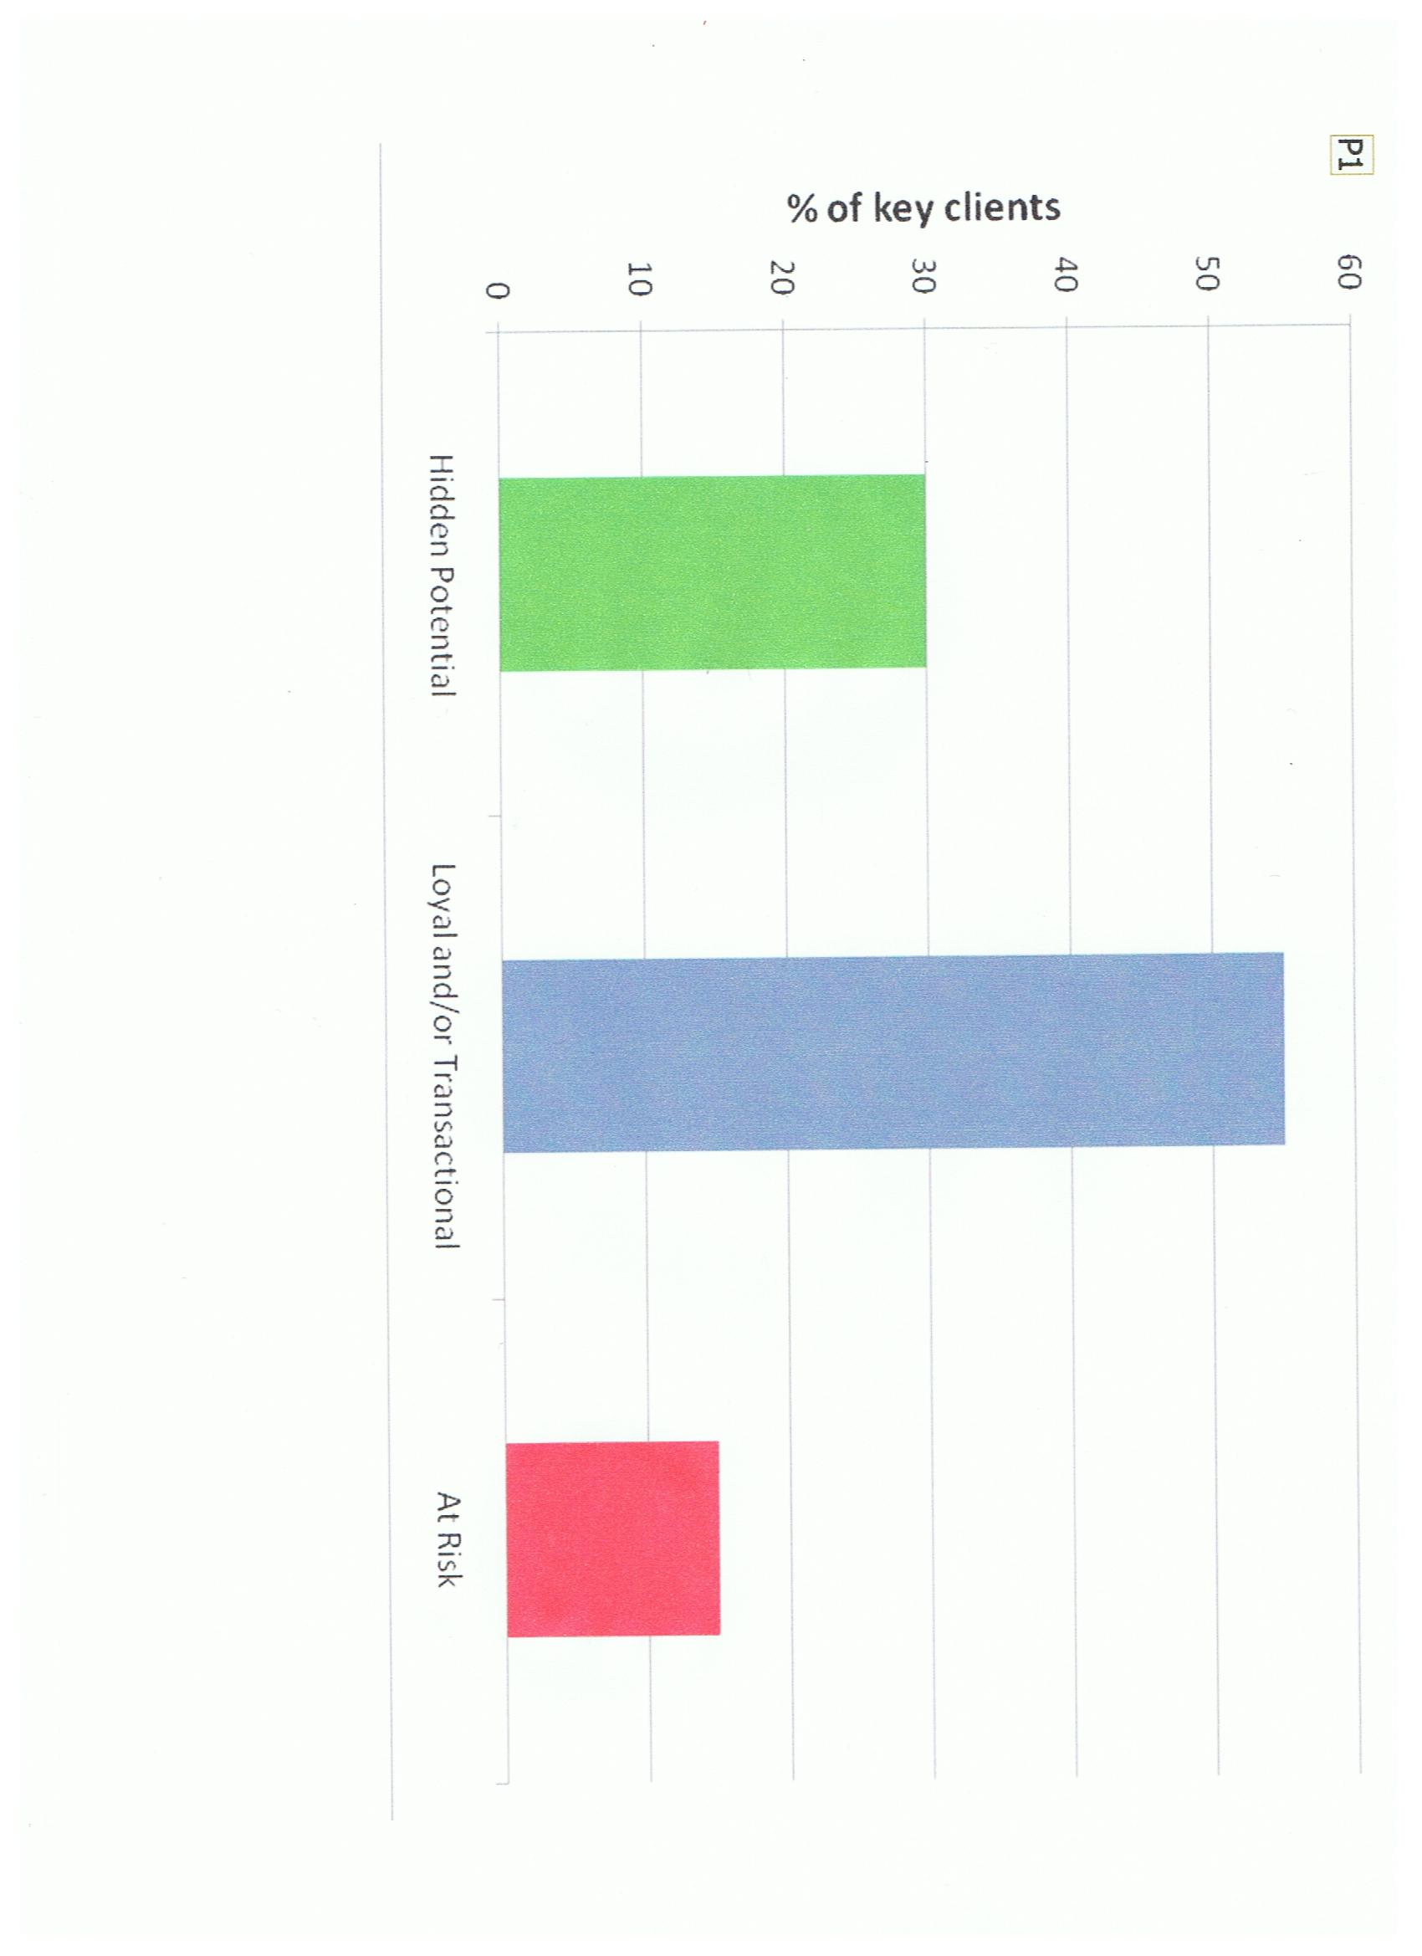
Typical professional firm client profile

Slide 16
To be unaware of or to ignore client and referrer perceptions is to put at risk a firm’s very existence Do you know which clients may be at risk?

Slide 17
Typical professional firm client profile

Slide 18
The untapped client base potential
It is not only the at risk clients firms should be concerned about.
The graph shows that typically three out of ten clients have hidden potential to grow that has not been identified.
Do you know your clients’ potential which could be unlocked for your firm?

Slide 19
The cost of sales
The cost and effort to ensure client satisfaction and thus the retention and development of clients is many times less than the cost of trying to win new business

Slide 20
Protect your backyard
This should be an obvious and profitable way to ensure
not only survival but also
one of the best ways to build long term competitive advantage
But are professional firms doing this?

Slide 21
What do clients value?
Client feedback from a client
“They always try to sell to us on price – but what
we really want is to have a good job done at a
reasonable price”
How will you be able to deliver value for money
– and still make your margin?

Slide 22
Core issue is to add value that clients care about
You will add value if…
You provide clients with what they need
At prices they perceive to be value for money; and
You do this better than your competition

Slide 23
How will you position your firm to compete?
High
Client
Perceived
Added
Value
Ave
X
Suicide Zone
Low
Low
Ave
High
Client Perceived Cost
Bowman and Faulkner 1994 Long Range Planning

Slide 24
Will your people be able to deliver what your clients are going to need?

Slide 25
Your people
What would your people say your firm values?
Do you measure it?
Do you reward it?
Do you invest in what you say you value?

Slide 26
Will your people deliver?
Are you unable to add value to your clients because of:
Gaps in your skills base?
Under performance?
Internal attitudes and behaviour?
A lack of investment in your people?
How hungry / passionate are your people about building the business?

Slide 27
What should your people be doing:
better?
more of?
less of?
differently?
How should your people be using technology more effectively to enable you to deliver what you clients will need?

Slide 28
Making technology effective
Technology without people does nothing
Professional firms are people businesses
People use technology
Are your people helping you to get the most
benefit out of technology?

Slide 29
Your IT
IT is a tool to be used by you in your business to help you be competitive
Is it doing so?
Do you analyse the cost / benefits of the IT you use?
Could you use it better to achieve your business objectives?

Slide 30
Your business objectives
Client service delivery
Financial management
Business development
Knowledge management
Risk and compliance management
Others?

Slide 31
Encourage your people to think creatively about how to use technology to:
Provide better service
Improve productivity
Build competitive advantage
Build profitability

Slide 32
You have developed a realistic post-recession plan, but…
Will a lack of resource make you uncompetitive?
- a lack of resource of expertise
- a lack of financial resource

Slide 33
Resource to enable you to…
attract and retain the best talent

Slide 34
Resource to enable you to…
provide clients with the depth
and breadth of expertise they
will need
when they need it
where they need it
And how they will require it to be delivered

Slide 35
Resource to enable you to…
build the quality management which will be
required to successfully compete in the future

Slide 36
Resource to enable you to…
provide the necessary support infrastructure
to underpin the effective provision of high
quality professional services

Slide 37
Resource to enable you to…
provide the necessary technology to make you
more efficient and profitable

Slide 38
Building resource to compete
How will you generate sufficient
resource to ensure your future
competitive edge?
Will you be able to do so on your own?
How will you use the resource generated?

Slide 39
Are there hurdles currently preventing your firm from becoming the kind of firm you want to create? If so, how do you propose to deal with them?

Slide 40
Any questions?

